Slide 1

House Price Predictor
Team Dataholics:
Gowrav Mannem

Slide 2
About the Challenge
Given a dataset with 12 features and Target Variable -house prices
Dataset has no Nulls or duplicated entries
Using these 12 features develop the most accurate regression model to predict House Prices.

Slide 3
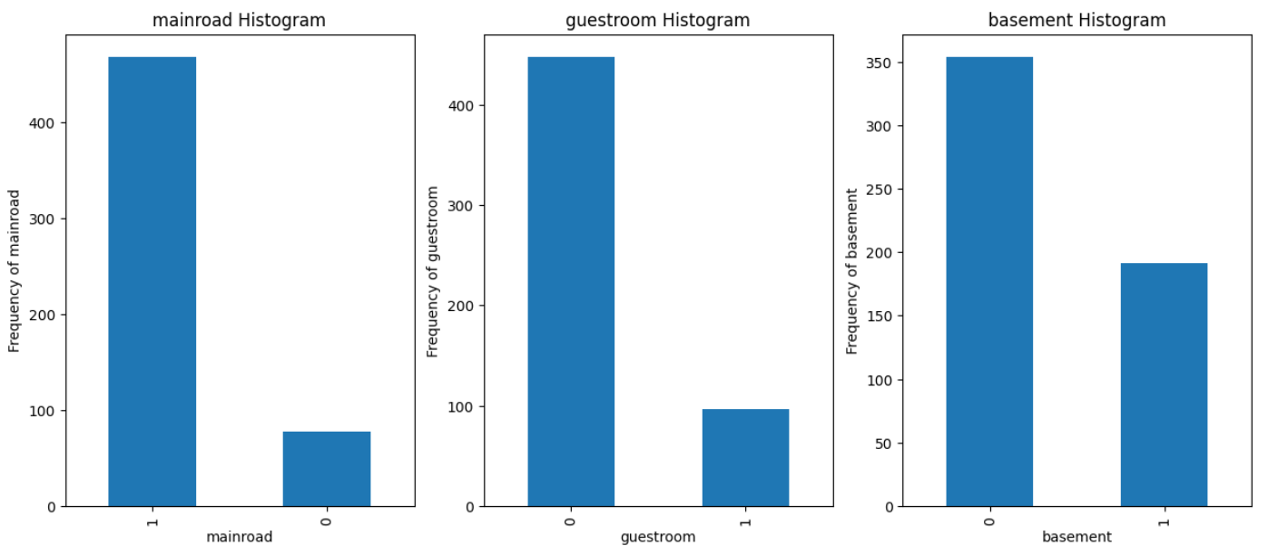
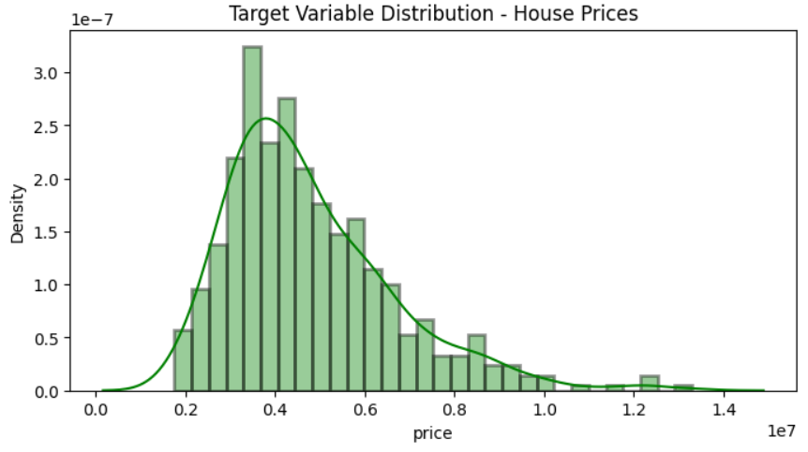
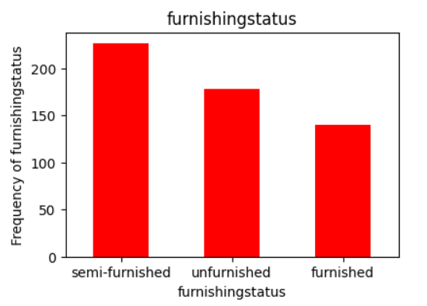
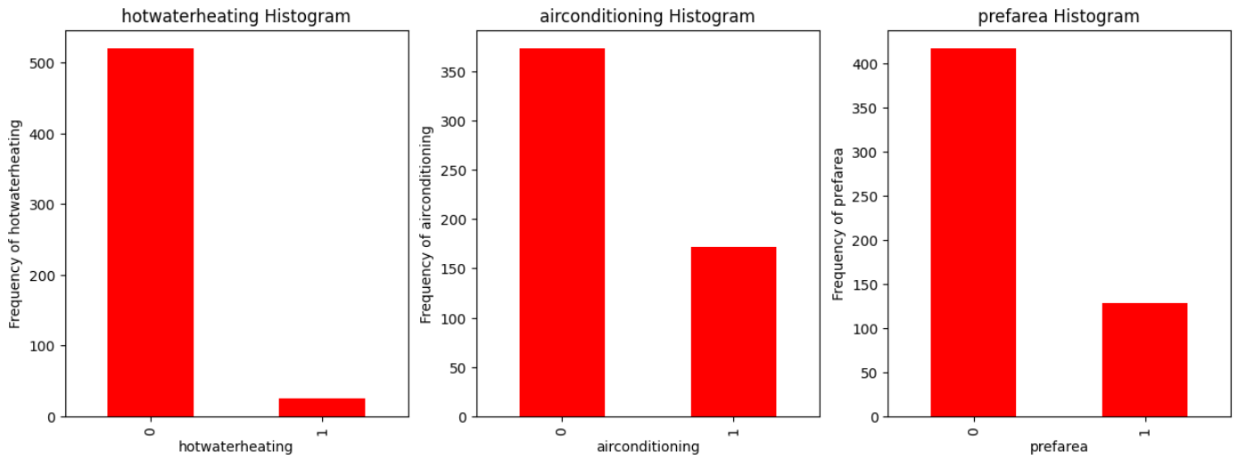
Exploratory Data Analysis

Slide 4
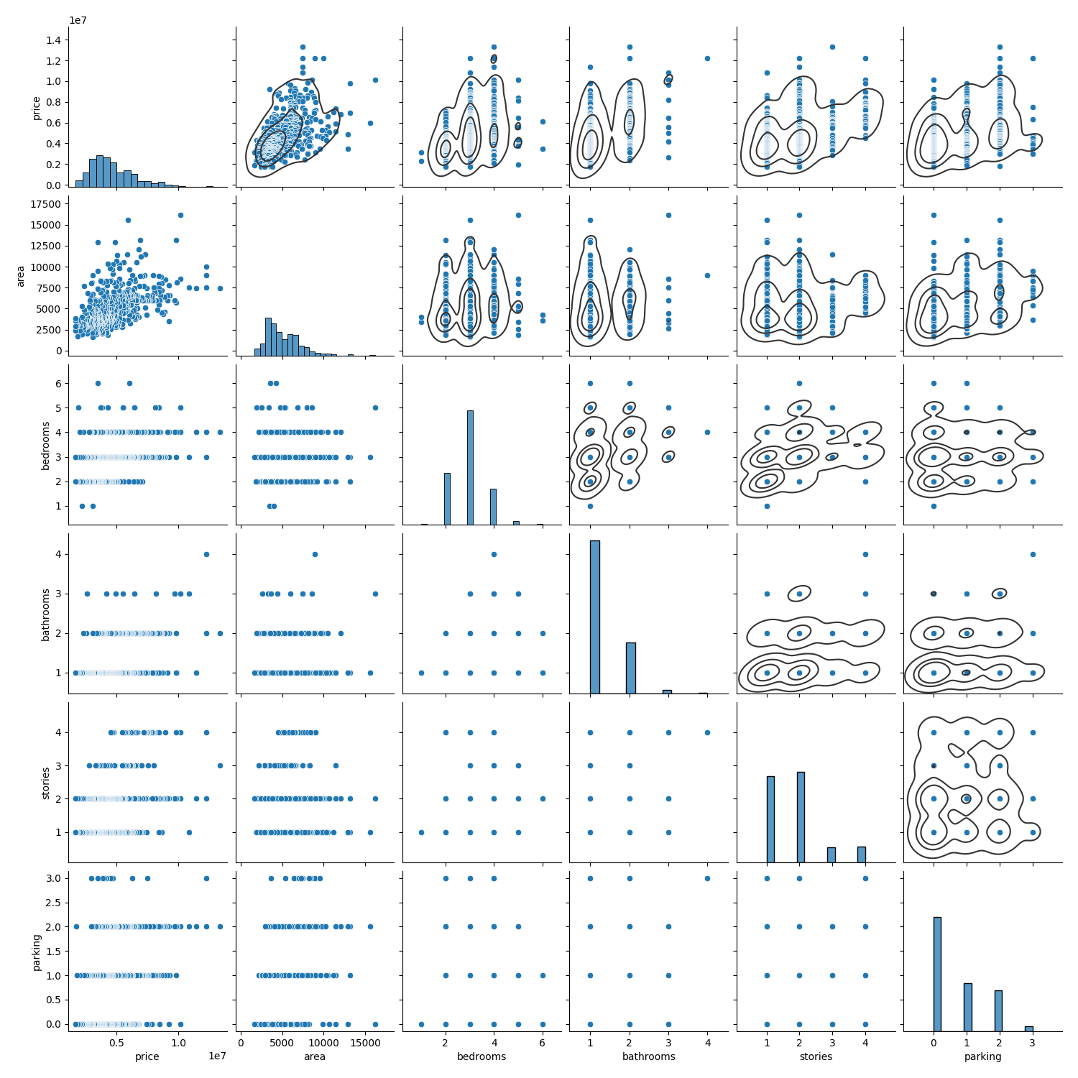
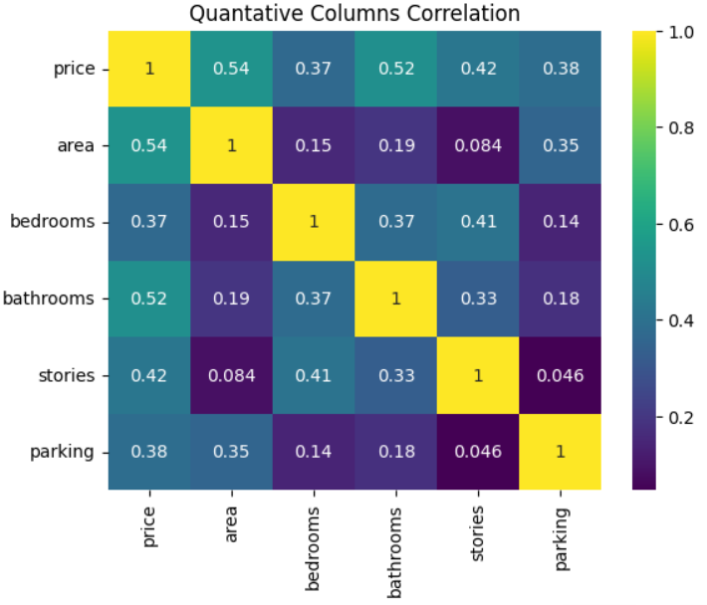
Correlation of Variables
All the quantitative variables have decent correlation to Price.

Slide 5
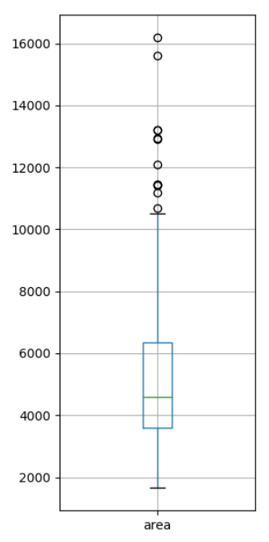
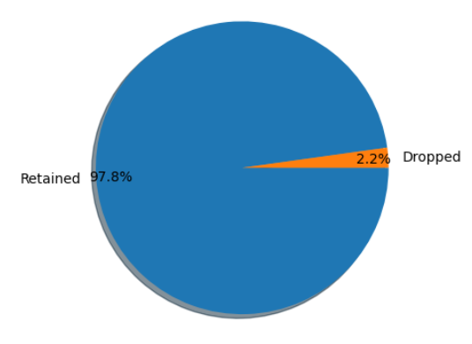
Data Cleaning
Removed 12 outliers in Area Column

Slide 6
Feature Engineering
One Hot Encoding
Applied to furnishingstatus column
Label Encoding
Applied to other Categorical Data
Applied Standard Scaler
Normalized data to boost model performance and robustness

Slide 7
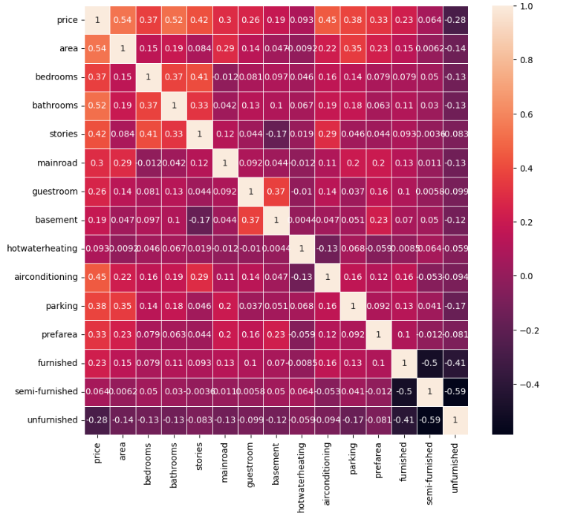
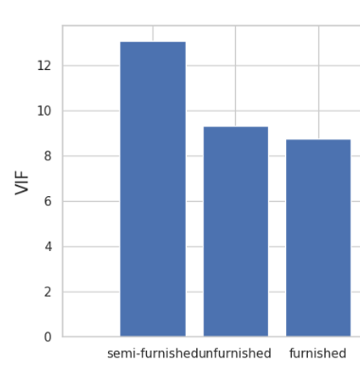
Tackling Multicollinearity
Removed semi-furnished, unfurnished, and furnished from dataset due to high VIF scores (>5).
This ensures that multicollinearity is not going hurt model performance.

Slide 8
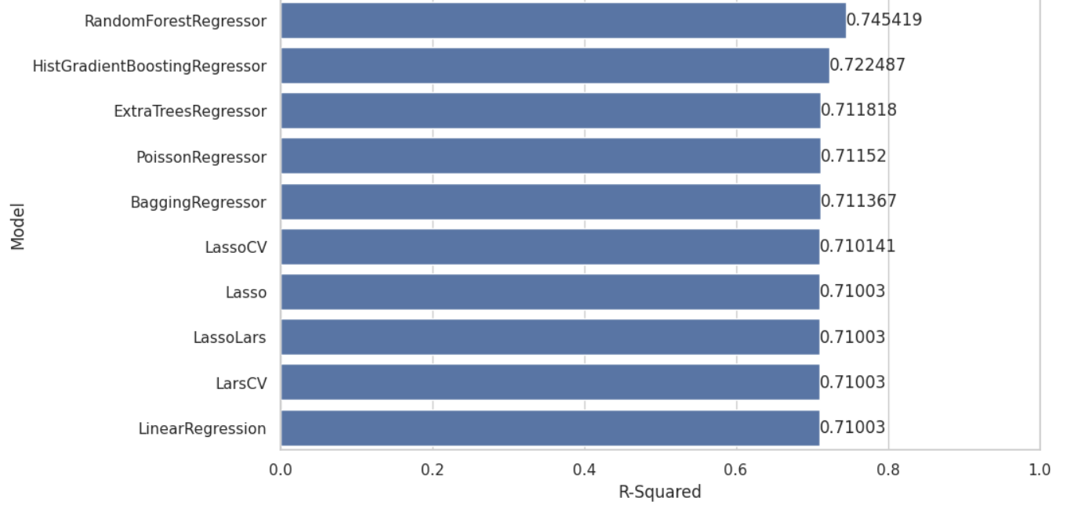
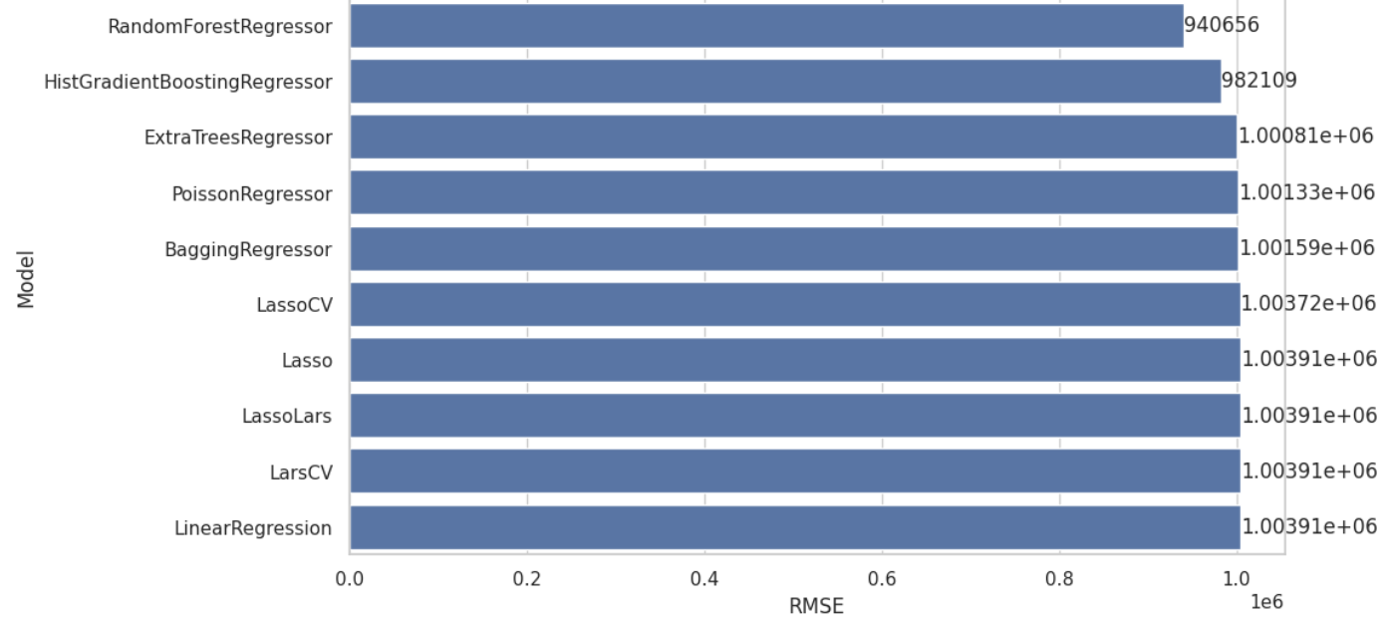
LazyPredict Results Random Forest Regressor is Best!

Slide 9
Hyperparameter Tuning
Tuning Method | Accuracy | RMSE
Base | 74.54% | 940656
RandomSearchCV (3 folds) | 82.86% | 974429
GridSearchCV (3folds) | 82.40% | 1012545
RandomSearchCV (5 folds) | 82.83% | 967879
GridSearchCV (5 folds) | 82.41% | 1012188
Best Model: RFR(n_estimator = 1000, min_samples_split=5, min_samples_leaf=2, max_features=10, bootstrap=True)

Slide 10

Next Steps
Try more Kfolds during Hyperparameter Tuning
Get more data to train and improve Model
Deploy this model to House Sales Website (Ex: Zillow)
Explore Neural Networks
Explore other Linear Regression Models not in LazyPredict

